Slide 1
Section 2.5 Continuity
Intuitively, any function y=f(x) whose graph can be sketched over its domain in one continuous motion without lifting the pencil is an example of a continuous function. In this section we investigate more precisely what it means for a function to be continuous.
That is, when the outputs vary continuously with the inputs and do not jump from one value to another without taking on the values
in between, we call the function is continuous.

Slide 2
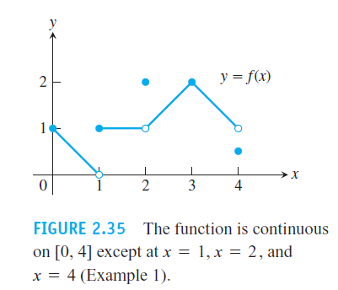
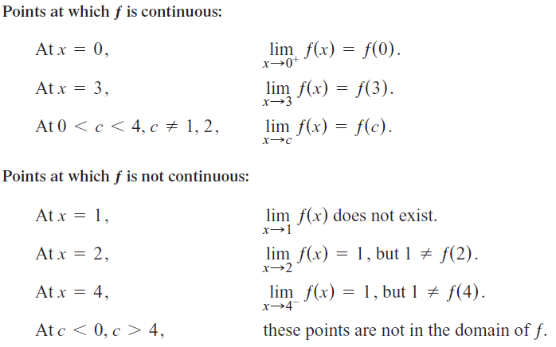
EXAMPLE 1 Find the points at which the function ƒ in Figure 2.35 is continuous and the points at which ƒ is not continuous

Slide 3
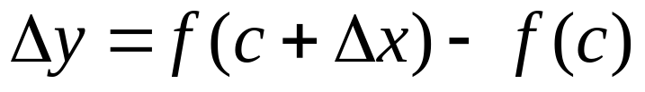

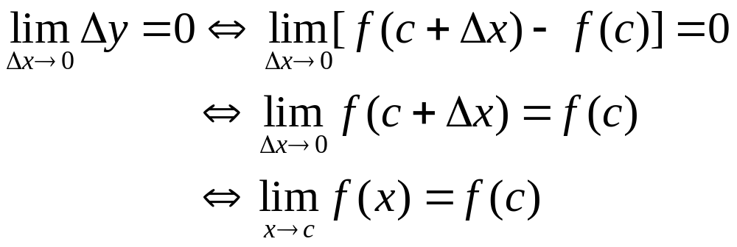
Let be the increment of dependent variable when the independent variable
has the increment.
Intuitively, the continuity at c indicates that approaches 0, must approaches 0.

Slide 4
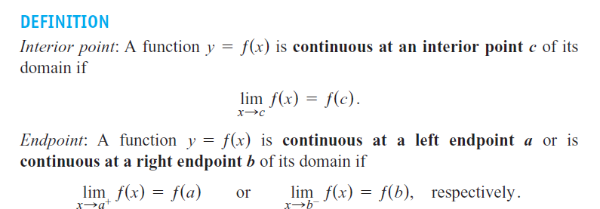

Slide 5

If a function ƒ is not continuous at a point c, we say that ƒ is discontinuous at c and that c is a point of discontinuity of ƒ. Note that c need not be in the domain of ƒ.
is right-continuous at a and continuous at a right endpoint b of its domain if it is left-continuous at b.

Slide 6

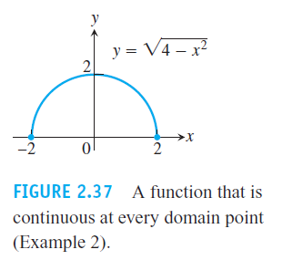

Slide 7
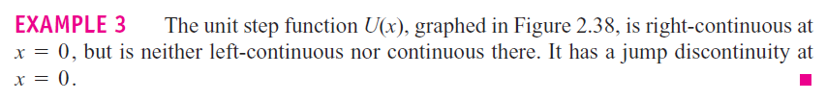
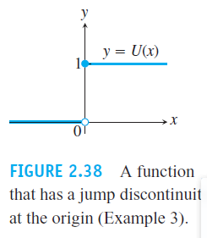

Slide 8
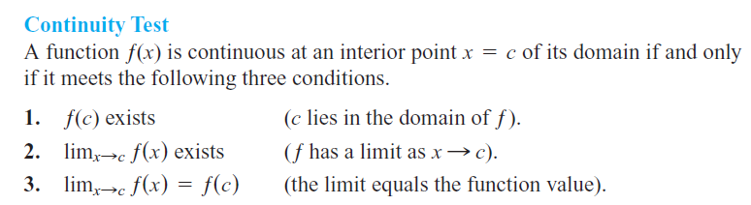

Slide 9
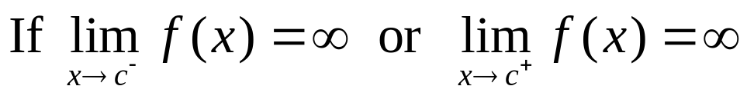
The classes of discontinuities: c is a discontinuous point
Removable discontinuity:
Jump discontinuity:
Infinite discontinuity:
Oscillating discontinuity: It oscillates too much to have a limit as x→c

Slide 10
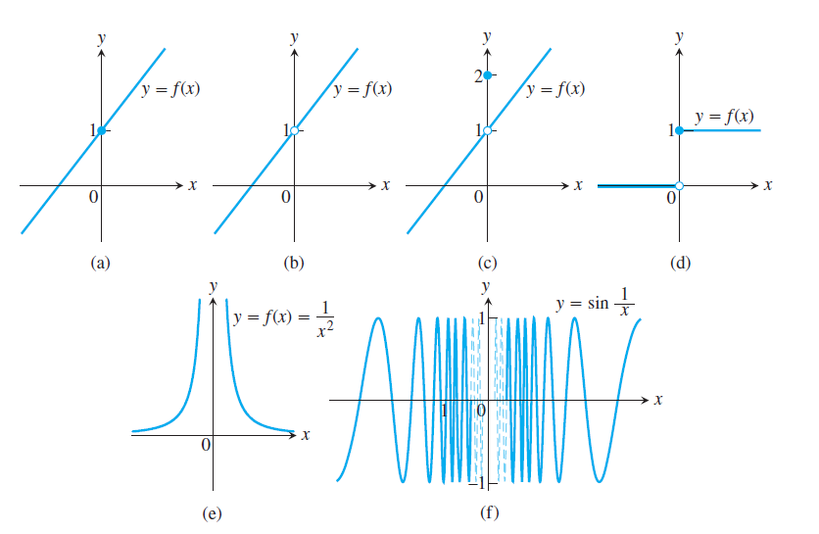

Slide 11
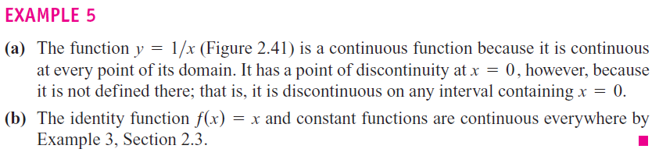
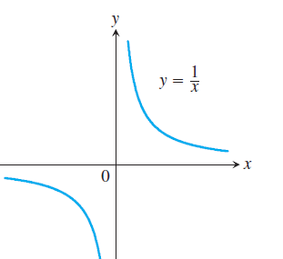
A function is continuous on an interval if and only if it is continuous at every point of the interval. A continuous function is one that is continuous at every point of its domain.

Slide 12
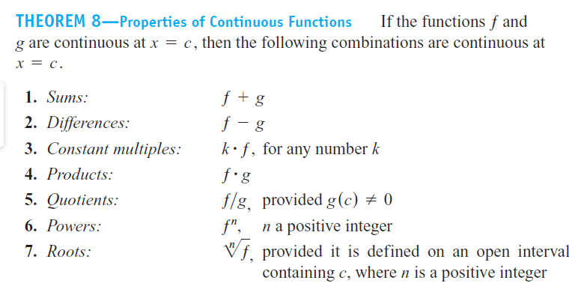

Slide 13
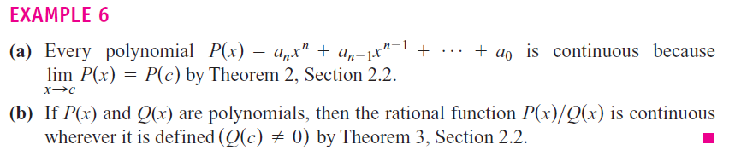
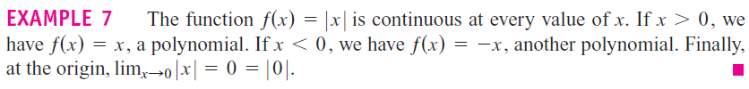

Slide 14

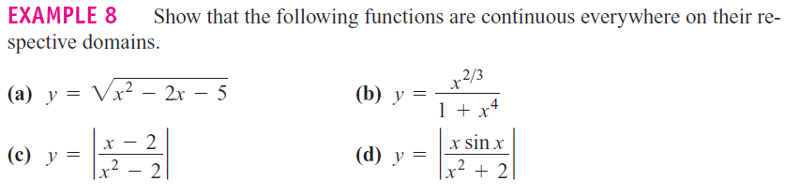
Notice: Every elementary function is continuous on the interval (open
,closed, or half open half closed) of its domain

Slide 15
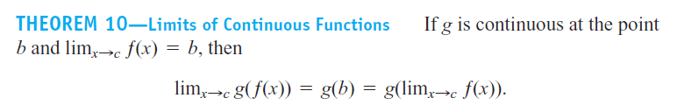
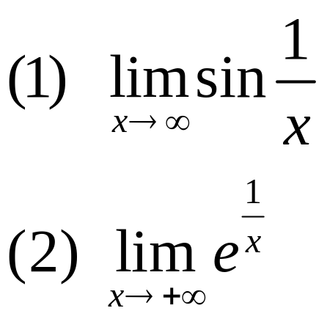
Example：Find the following limits：

Slide 16
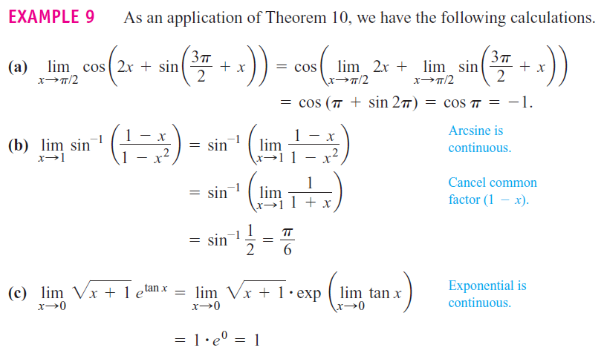

Slide 17
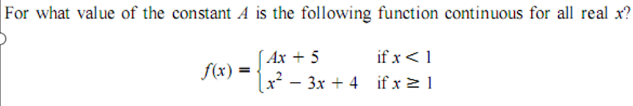
Example：

Slide 18

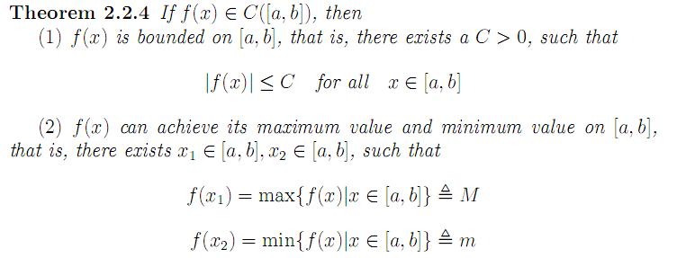

Slide 19
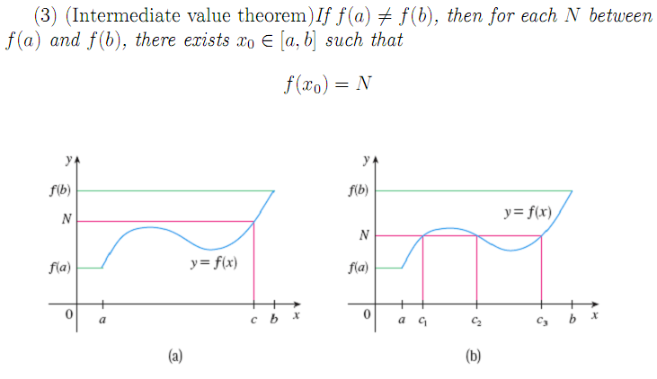
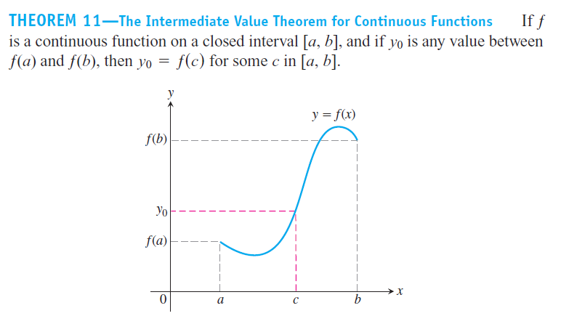

Slide 20
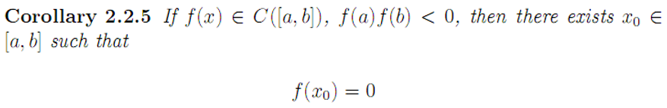
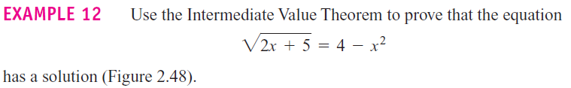

Slide 21
Homework: P101 16, 26, 30,35, 48, 55

